Slide 1


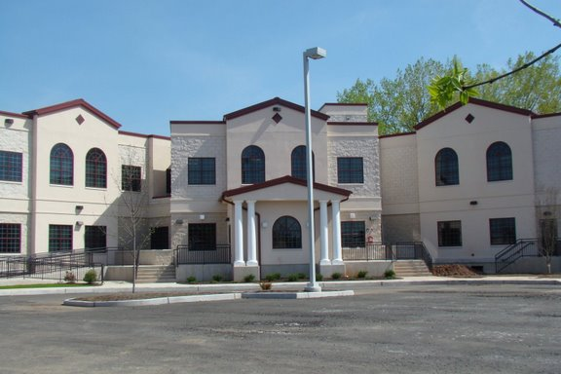
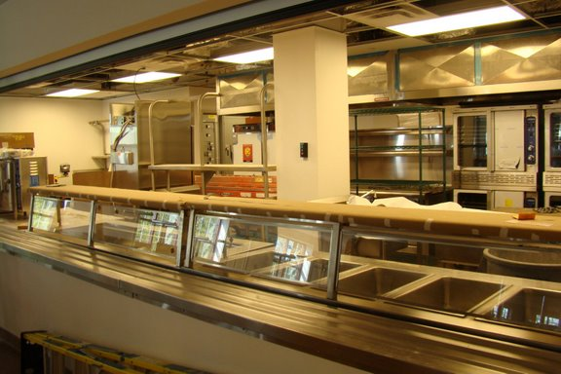

THE BERGEN COUNTY HOUSING,
HEALTH AND HUMAN SERVICES CENTER
A SHARED PROJECT BETWEEN THE
COUNTY OF BERGEN
AND THE HOUSING AUTHORITY OF BERGEN COUNTY
“A COLLABORATIVE APPROACH
TO MEETING HUMAN SERVICES NEEDS”
Best Practices in Ending Homelessness: 2nd Edition
Trenton State House
Bergen County Ten Year Plan to End Homelessness 2008

Slide 2
Getting to Zero*
Ending chronic homelessness takes political will, leadership, collaboration and coordination among multiple state and local programs to align resources for housing and supportive services
  * Adapted from USICH 10 Strategies to End Chronic Homelessness

Slide 3
Bergen County 10 Year Plan to End Chronic Homelessness 2008
Focus groups 2007- (200 community participants)
  Analyze the shortfalls/barriers in the current system
  Develop strategies to reorganize/recreate a system to quickly respond to those experiencing homelessness.
    Permanent Housing
    Services Provision
    Discharge Planning
    Education and Advocacy
    County Level Re-organization of Homeless Services Dollars
Model Project (BCHHH Center)
  Develop and expand Housing First
  Create a rapid re-housing program for individuals & families
  Develop a One-Stop Center

Slide 4
Shelter design contrast
Bergen County, NJ
Old System (prior 2009)
New System (after 2009)
4 temporary shelters (some sub-standard)
Seasonal, sit-up
EA only, hard to access, SU banned
4 different intakes
Housing access limited
8 beds for women
One new, clean, safe and welcoming shelter
Year-round, 24-hour
Housing First
Coordinated entry
Housing access prioritized and immediate
45+ beds for women

Slide 5
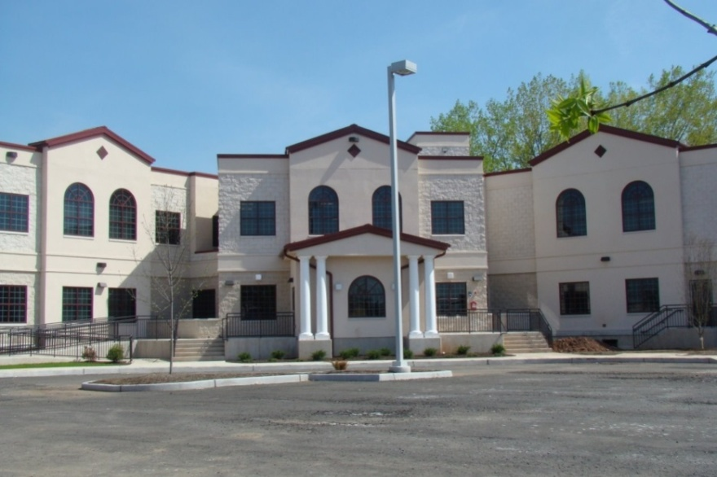
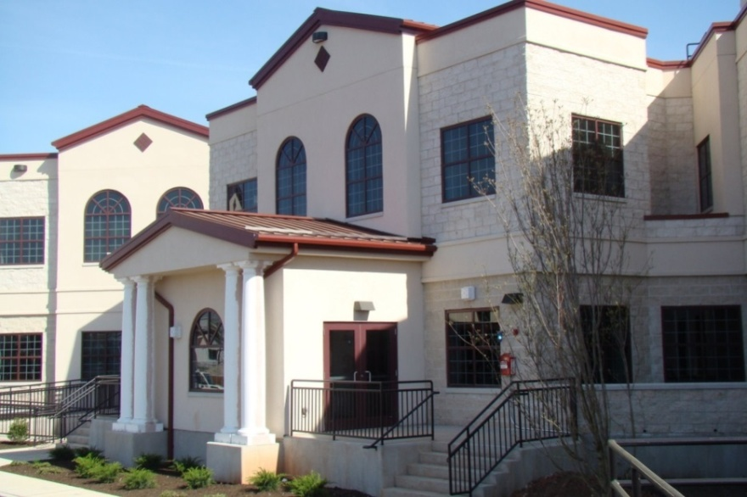
Mission
Permanent housing with support services
One-stop location and single point of entry
Prevent homelessness / rapidly re-house individuals

Slide 6
5 Keys of A best practices Low Barrier & Housing Focused Shelter (NAEH)
    Housing First
    Immediate and Easy Access to Shelter
    Housing Focused Services
    Rapid Exits to Permanent Housing
    Data Driven

Slide 7



KEY DESIGN CONCEPTS
Objectives:
End chronic homelessness,
prevent homelessness & successful re-entry
Approach:
The Housing First Model
Process:
Engagement, Collaboration, Integration
Bergen County Housing, Health and Human Services Center

Slide 8

KEY DESIGN ELEMENTS
ONE STOP MODEL
  Engage community decision makers during the design phase
  Create resource based contractual partnerships
  Incentivize onsite agency involvement
  Provide services to accelerate housing placement
  Offer aggressive daytime programming
  Pilot test the concept
Bergen County Housing, Health and Human Services Center

Slide 9



BUILDING AMENITIES & SERVICES
27,516 square feet of
new construction including:
  Nutrition site
  (3 meals a day: 2 for community)
  Shelter space for 90 + 15 in Winter
  Drop-in Program
  365 Days (9:00am-4:00pm)

Slide 10




BUILDING AMENITIES & SERVICES
Open 24 Hours-Guests can stay on premises
Showers, bathrooms, storage, laundry facility
Computers, mail service and telephones
Wellness Services (Shared Services Jail)
Flexible Office Space

Slide 11


FLEXIBLE SHELTER SPACE
Licensed 90 Day Emergency Shelter
Individuals, Couples, Adult Families

Slide 12

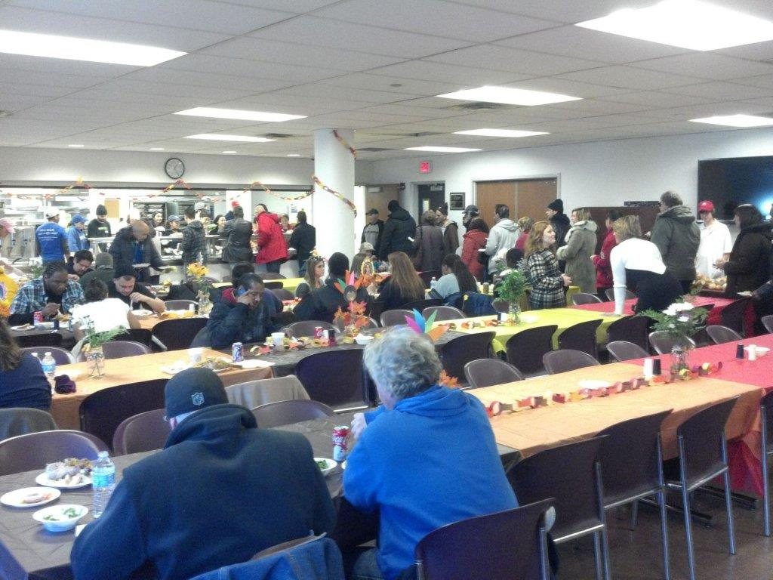
NUTRITION CENTER
(73k Meals Annually)

Slide 13


VOCATIONAL OPPORTUNITIES

Slide 14

HABC Under Shared Services
Management and Administration of Center
Clinical oversight and Care Management Services
Facility Management
Dedicates 20% of Vouchers to shelter population. EA billing and interface with BCBSS
Housing Specialist on-site to determine eligibility/provide voucher issuance
Administer HPRP and ESG funds on-site

Slide 15

Transitions to Home
Transitioning to stable housing
  Identifying client strengths and needs
  Identifying community resources
Sustaining permanent housing
  Consistency with case management (face to face follow-up)
  Making sure the client is accountable
Healthy and robust connections with landlords who would overlook background checks and poor credit
  Create relationships, establish rapport and respect preferences (vouchers, etc)
  Start with less difficult cases with new landlords
  Make sure they can reach you, and address issues directly with the client
Collaboration very helpful and Communication is key

Slide 16
SOURCES OF FUNDING
Federal Stimulus Funds (HPRP)
BC DHS State SSH Funding
Federal Funding (CDBG, ESG, HOME and FEMA)
Bergen County Homeless Trust Fund
Philanthropy for Special Services
Homeless Trust Fund

Slide 17
Getting to Zero*
      Persistent, coordinated and creative outreach (Person Centered)
        Reduce Barriers for applicants
      Housing First System Orientation and Response
      Engage and Support PHA’s to increase supportive housing through limit preferences
      Set and Hold Partners Accountable to Ambitious Short-term Placement Goals
        Adopt “Surges” to break down the larger goal into focused blocks of time and effort
        Creating and Sharing community-wide lists
        Using Assessment Tools to prioritize and target interventions
        Monitor progress at least monthly

Slide 18

PIT OUTCOMES 2010-2016
Unsheltered homeless decreased by 84.7%
Chronic homelessness decreased by 86.8%
All-Star participants in 100k campaign
Only NJ Community participating in Zero 2016

Slide 19
OUTCOMES 2010-2016
1100+ individuals placed in permanent housing
  (1/4 chronic)
465 + homeless prevention/rapid re-housing assistance ended 2012 (HPRP)
220+ homeless prevention/rapid re-housing assistance began 2012 (ESG)
Less than 5% recidivism rate

Slide 20
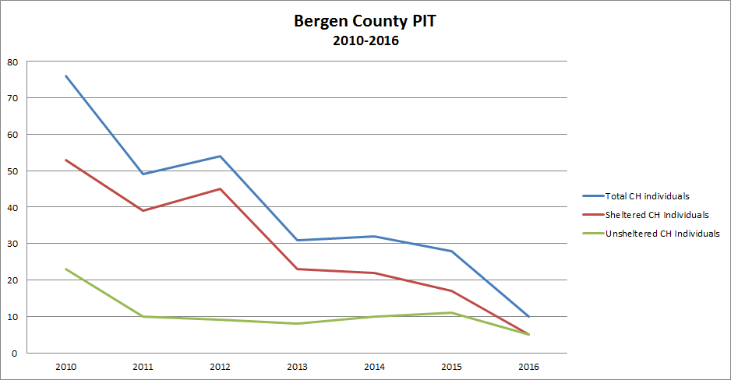
PIT Data Chronic Homelessness 2010-2016

Slide 21
it takes a village…
Case Study: Ms. M
Ms. M
Process (7 Years)
Very long hx of psychiatric inpatient (state hospital), past group homes and long homelessness.
Significant issue with immigration documents
Very visible presence
Nomadic
Sporadic contact
Take a knee/negotiation
Collaboration-Senator M
Low barrier-no barrier
Bad day vs. good day
Whose your BFF?
Length of stay-plan
Transparency and constant communication
Incentives
Fight isolation-safety net-touchstone

Slide 22
Criteria for Ending Veteran Homelessness (USICH 2016)
The community has identified all Veterans experiencing homelessness.
The community provides shelter immediately to any Veteran experiencing unsheltered homelessness who wants it.
The community provides service-intensive transitional housing only in limited instances.
The community has capacity to assist Veterans to swiftly move into permanent housing.
The community has resources, plans, partnerships, and system capacity in place should any Veteran become homeless or be at risk of homelessness in the future.

Slide 23
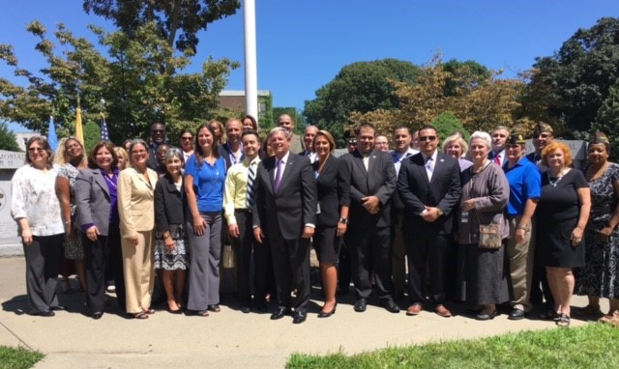
Bergen County Ends Veteran Homelessness July 28, 2016

Slide 24
Criteria for Ending Chronic Homelessness (USICH 2016)
The community has identified and provided outreach to all individuals experiencing or at risk for chronic homelessness, and prevents chronic homelessness whenever possible.
The community provides shelter/temporary accommodations immediately to anyone experiencing unsheltered chronic homelessness who wants it.
The community has implemented a community-wide Housing First orientation and response that also considers the preferences of the individuals being served.
The community assists individuals experiencing chronic homelessness to move swiftly into permanent housing with the appropriate level of supportive services and effectively prioritizes people for permanent supportive housing.
The community has resources, plans, and system capacity in place to prevent chronic homelessness from occurring and to ensure that individuals who experienced chronic homelessness do not fall into homelessness again or, if they do, are quickly reconnected to permanent housing.

Slide 25
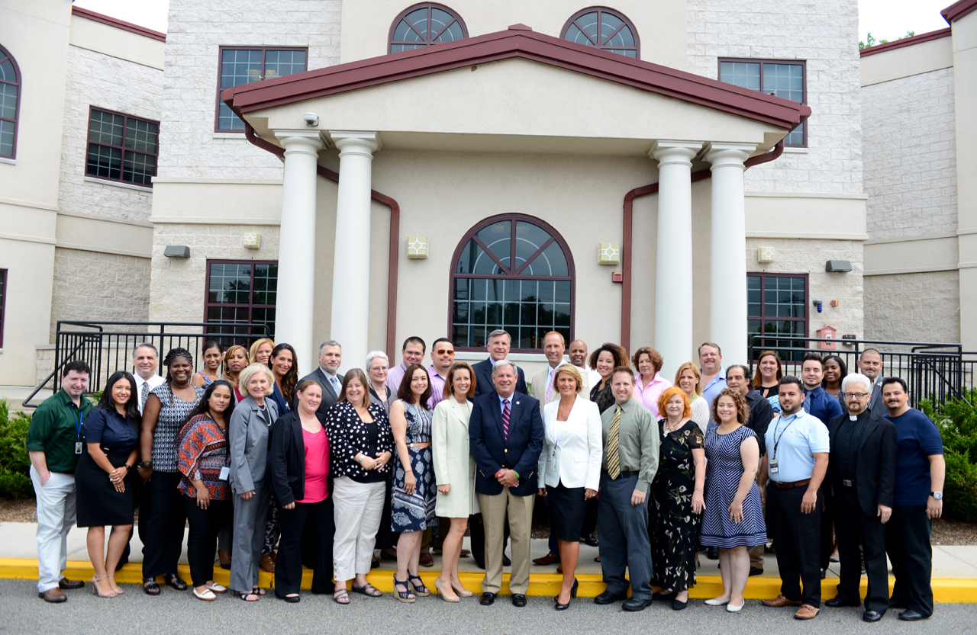
Bergen County To End Chronic Homelessness…Stay tuned

Slide 26
At-Risk List
Individuals who have been homeless for more than a year without a documented disability.
Individuals with a documented disability and significant homeless history (currently 180+ days).
Homeless individuals who have been identified by either shelter staff or outreach/advocates as having great difficulty identifying or accessing housing (this includes individuals who have failed other housing options and have returned to homelessness multiple times).
Bergen County Housing, Health and Human Services Center

Slide 27
Contact me:
Julia Orlando, DRCC, CRC, Ed.M, MA
orlando@habcnj.org
201-336-6476

